Slide 1

Practising data science in the real world
Limitations and challenges
Dimitri Scronias, ORS PACA/AP-HM

Slide 2
What is this class about?
Make you think critically about data and statistical methods
Basics you should be able to do/think about as a statistician, data scientist, etc.
Issues and difficulties surrounding data you will encounter in your work
Mainly targeted to people working directly on raw data…
However, you can still benefit from it even if you won’t: everybody works using data at some point
Practical exercises using (mainly) dirty data
Notes:
Practical exercises using (mainly) dirty data: tell them that’s a problem and that working on toys dataset doesn’t prepare you to all the data manipulation you’ll have to do

Slide 3
How I made this class
Multiple books, which I reference throughout the course (have a look at them!)
My personal experience, stuff I wish I knew when I started working
Issues/problems I think you should be aware about as a DS/stat
Though nobody will expect you to be experts on these subjects!
What I would like you to know if I were to interview you for a stat/DS position
Also, my goal is mainly to make you employable as a stat/DS, and give you a rundown of common challenges, possible solutions and good resources in a condensed format

Slide 4

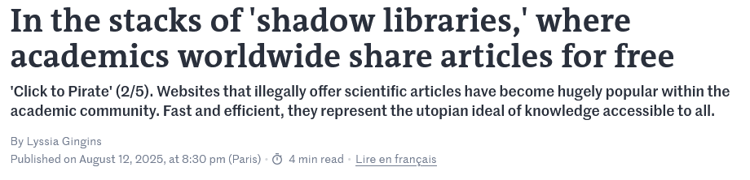
On the matter of books
Whenever I can, I try to reference free books that you can find online
However, some of these are paid
Here is an interesting article in Le Monde you should read
Notes:
It’s quite obvious, but paid books aren’t necessarily better than free ones.
Reminder: archive.ph (it’s for archiving web pages, don’t mention anything else)
Don’t mention any website name

Slide 5



Who am I?
2021–24 Assistance Publique – Hôpitaux de Marseille, ORS PACA
Soladis Group, ATIH
2019–21 Assistance Publique – Hôpitaux de Paris, ORS PACA
2021 DESU Data Science, AMSE
2019 M2 Economics – Economic Policies Analysis, AMSE
Notes:
Same background as you
Statistician/data scientist/whatever since 2019
Already taught this class last year (it went well I think?)

Slide 6


Stuff I have worked on
Vaccination
Opinions and practices of healthcare workers (general practitioners, nurses, specialists) w.r.t. vaccination
GPs’ recommendations practices of COVID-19 vaccines
Vaccine coverage and delays among French children
Emergency services’ quality of care, pressure, classification of diseases
Neurodegenerative diseases
Costs measurements of Parkinson disease from RWD

Slide 7

Stuff I have worked on
Big databases:
RPU + PMSI: all hospital and emergency stays in France
SNDS: biggest healthcare database in France (and Europe?), it contains all medical reimbursements, patient and physician data (+ other things) in the country. Some tables easily get billions of new rows every year

Slide 8

Internships (1)
I typically hire interns every year at the ORS:
2024: 1 student from M2 MASS POP, for 6 months. Worked on an imputation methodology for the national emergency service datasets (RPU, ~20 million stays each year in France)
2025: 2 DADEE students, for 6 and 3 months.
One worked on writing a paper about a novel complexity scale for emergency stays based on ICD-10 diagnostics
The other worked on the validation of an adequacy indicator for emergency stays using survey data among physicians in emergency services
2026: no plans yet, but it is likely we will have work to give
The internships always involve statistical work
Notes:
And probably other things that I have forgotten about

Slide 9
Internships (2)
Stats will be done using R (+ maybe a bit of SAS)
This is non-negotiable (:
The complexity of the statistical work will vary
It is very unlikely to involve heavy Machine Learning or Big Data
Good opportunity to get a foothold in research
Other info:
The pay is the legal minimum in France (~600€ a month?)
It is very unlikely we will hire you after the internship (because no 💸)
35h/week
English is fine (it’s a plus if you can speak a bit of French so you can get along with the other colleagues)
Location: Faculté de Médecine de la Timone, in Marseille
Notes:
And probably other things that I have forgotten about

Slide 10
Additional info on the course
Centered on:
Tabular data
Public health (with individuals as objects of analysis, mostly)
We’ll alternate between classes and labs where you’ll have to work on data
This class was supposed to have parts about data privacy, regulatory and legal constraints, etc…
This is arcane knowledge to me, so you’ll have programming exercises instead

Slide 11
Github/Final assignment
There is a GitHub here
It contains all the class material, exercises, and some other material (like my resume in LaTeX if you want to reuse the code)
I am likely to update a few things in the course content, just check sometimes that what you downloaded is up-to-date
Also, it contains the final assignment
It used to be a written report only (code + report)
Starting this year, I am required to add an oral exam on top of it
The reason is because of the increase of AI usage among students in reports/homework (y’all keep copy-pasting ChatGPT responses without thinking)
So written and oral exams are now preferred

Slide 12
Final assignment
Be sure to frequently check this document, I will add more information to it
In a nutshell, I want you to: find a messy dataset, find some business/research question, clean your data, create new variables, discuss potential biases in your data/model, present results

Slide 13






AI: my stance in this class
For writing
I don’t mind as long as you don’t blindly copy-paste responses without thinking
I use it myself as an “assistant” to explain problems I have (a.k.a. rubber ducking), get new ideas, translate things…
Keep in mind LLMs can very convincingly hallucinate: fake references, events that never happened, confuse people, “reasoning” error, etc…
Notes:
Explaining your problems in writing or to someone is actually great for problem solving : https://en.wikipedia.org/wiki/Rubber_duck_debugging

Slide 14
AI: my stance in this class
For coding
Choose your poison:
Integrated AI assistants (Github Copilot, Codium…): these work within your IDE (not R Studio though, try VS Code), they may have context awareness of the project your work on (i.e. know your other codes)
Not integrated: ask your problem on the LLM of your choice (GPT 4, Claude…)
Some are better than others for coding
Check benchmarks on the Internet (Claude is usually near the top)
I wouldn’t recommend paying for it
Free tiers are enough, just wait or change LLMs if you’ve reached the daily limit for the more complex models if you need them
Notes:
Also: use them while they are free. They are currently operating at huge losses (and you may have heard of the AI bubble). Maybe all the business models will change in the future, who knows.

Slide 15
AI for R programming
If you use it for R programming:
Check from what packages are the functions they use (e.g. base R? Tidyverse? Data.table?), you can specify in your prompt if they should prioritize some families of package (Tidyverse, for this class)
If you encounter a function you do not know about, read the documentation about it
Learn how to read/navigate packages documentation, this will help you
One intern that I had had a while ago used to copy-paste LLM codes, without checking or trying to understand what it was doing. NEVER DO THIS.
Chances are some chunks of code may be entirely useless.
Prioritize using AI to get code for well-known packages
Don’t bother with smaller/less-known ones, LLMs will be likely to hallucinate

Slide 16

Last advices before starting
For jobs in France, try the APEC: I was called 3-4 times a week for DS/biostatistics positions by recruiters when I posted my CV there
Check the average salary for your job on Glassdoor or the APEC, bump that by 10% when negotiating
If you want to train for interviews, go to job fairs and talk to literally everyone
Remember you are trying to sell a product: yourself, a capable working professional
If your goal is to increase your salary quickly, don’t stay in the same company
Notes:
Check the average salary for your job on Glassdoor or the APEC, bump that by 10% when negotiating: worst thing they will say is no
Talk about my salary

Slide 17

Questions? I’ll answer questions about jobs, work experience as a data scientist, projects, life…
dimitri.scronias@inserm.fr

Slide 18
Summary
“So, can you tell me about the different steps in a data project?”
—Some recruiter (whose name I forgot)
Notes:
ASK STUDENTS WHAT THEY THINK

Slide 19
Summary
Defining needs
Data manipulation & cleaning Missing data & imputation, data quality and reliability…
Modelling Bias and fairness, interpretability and explainability, scalability and performance
Communicating results Communication and collaboration
Plus: programming exercises in-between

Slide 20


I. Defining needs

Slide 21
What we’ll see
Defining data and data science: what it is, what it is not
Planning your analyses:
Doing a data analysis plan
Data types
Modelling strategies
Pre-hoc variable selection
Tools and software

Slide 22
Resources
Simon Thompson. 2023. Managing Machine Learning Projects: From design to deployment
Provost F., Fawcett T. 2013. Data Science for Business: What you need to know about data mining and data-analytic thinking (2013)
Ameisen, Emmanuel. 2020. Building Machine Learning Powered Applications: Going from Idea to Product

Slide 23
🌈Data science🌈 What? Why?
DS involves “principles, processes and techniques for understanding phenomena via the analysis of data” (Provost F., Fawcett T.)
Main goal: help decision-making (Data-Driven Decision Making)
Avoid uninformed decisions like “we have always done it this way”, counterproductive “intuitive decisions”, or sometimes plain stupidity or dangerous decisions.
Notes:
Ask students what data science is

Slide 24
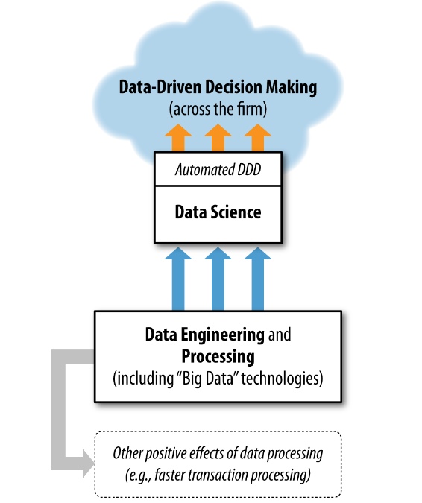

🌈Data science🌈 What? Why?
Very simplified model of the goal of DS in a firm
DDD associated with increase in productivity in a firm
Keep in mind sometimes DS is not used for decision making! (but that is what we will focus on)
This graph is… not great. It is disconnected from
Provost F., Fawcett T. Data Science for Business.

Slide 25
Key takeaway (read this every night before bed)
Your job is to make data interpretable for decision-makers to make informed, data-driven decision.
Remember you will be dealing with people that:
Do not understand statistics as well as you;
May be focused on getting results.
Key skill: learning how to simplify complicated findings from data
Notes:
Does not understand statistics as well as you: that will be something new for you when you get into your new job. You now might be one of the most knowledgeable person about stats/economics/other where you work at (except for seniors).
The end goal is this. Not fancy models. Not LLMs. Not AI. Not idk what.
Doing data science is useless if you can’t communicate your findings clearly

Slide 26
But what is data?
“Factual information (such as measurements or statistics) used as a basis for reasoning, discussion, or calculation”
— Merriam-Webster
“The word ‘data’ is commonly used to refer to records or recordings encoded for use in computer, but is more widely used to refer to statistical observations and other recording or collections of evidence”
— Zins C. (2007). Conceptual approaches for defining data, information and knowledge.
The article above contains more than 40 definitions for data.
Notes:
WHAT DO YOU THINK DATA IS?

Slide 27


Deconstructing data
Data comes from Latin “dare”, “to give”.
“Data are (or datum is) an abstraction. I mean, the concept of ‘data’ or ‘datum’ suggests that there is something there that is purely given and that can be known as such. […] There is nothing like ‘the given’ or ‘naked facts’ but that every (human) experience/knowledge is biased.”
— Zins C. (2007). Conceptual approaches for defining data, information and knowledge.

Slide 28
Data as obtained, not given
Good data is difficult to obtain:
Questionnaires, often costly and difficult to administer
(Underpaid) workers that label millions of images for generative AI
Human input in software (e.g. emergency services, hospitals…)
Complicated pipelines of automated systems (e.g. French National Health Insurance)
These are the first layers of human biases, subjectivity or potential errors than can bias your data
Notes:
Questionnaire: also, need to be sure the questions are well understood, that respondents are not faking everything, plus depending on how you administer questionnaires (online, phone…) you have different problems like costs, bots responding…
One time, in a project, we had to scrap half of the responses to an online questionnaire, because we eventually realised that their respond times were unrealistic, and it fact we found out the respondents were robots
When AI Eats Itself: On the Caveats of Data Pollution in the Era of Generative AI
https://arxiv.org/abs/2405.09597

Slide 29

Data as capta
Johanna Drucker (researcher in digital humanities) talks of capta: “Data are capta, taken not given, constructed as an interpretation of the phenomenal world, not inherent in it.”
Also: “Data are never neutral, but always constructed from some point of view, with a specific set of values and beliefs.”
Check out The Digital Humanities Coursebook, which offer a fresh perspective and counterpoint to typical data science courses
J. Drucker also does nice art
this is irrelevant to the course
Notes:
Drucker 2011: https://dhq.digitalhumanities.org/vol/5/1/000091/000091.html

Slide 30
Data lifecycle
Or “why data is not objective”
All the steps your data go through, from being recorded to being transformed, interpreted and communicated.

Slide 31




Data lifecycle
Before you think about data, there is this
The world is full of phenomenon that you want to measure. Let’s take happiness in a country.
“National happiness” is a concept
People experience it in various heterogeneous ways
It exists, but it is not data
You will never fully observe it, nor capture it
This phenomenon exists before you capture it as data
Notes:
You can call it: phenomenon, reality, state of the world, latent construct…
It’s a bit philosophical but it is an important thing to keep in mind: data does not just appear, it is not just “there”. Data will be the medium you use to capture this phenomenon.
I think as a first step, you shouldn’t think about “data”, but about the underlying reality or construct that you are trying to measure with data.

Slide 32
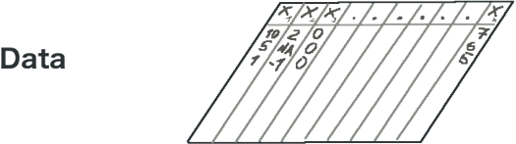
Data lifecycle
Data is a representation of this phenomenon. Many mediums:
Your brain, a photograph, an audio recording, a table, writing, a drawing…
It is already subjective, interpreted:
What you are trying to measure, why, and how are influenced by your sociocultural context
The data might not fully represent the phenonemon (selection bias)
The very process of capturing data introduces errors (measurement errors)
Data is not constant: it can be lost, corrupted, altered over time
Capture
Notes:
Arguably, at no point is your data ever objective.
Also, the way you capture or produce data is also a modelling process: when, how, who captures it, what you actually capture…

Slide 33
Data lifecycle
Before analysis, data is often processed
This is both an act of creation and destruction
You can derive new data from what you have (variable creation, imputation…)
Modify or destroy it (cleaning, removing missing data, outliers…)
Processing involves modifying the data such that it conforms to your interpretation of how the data should be
Capture + process
Notes:
I think the last line is especially important. You should always watch out for the usual “data science” rhetoric. Like “data cleaning” for example. Why is the data that you already have not “clean”? Cleaning implies that you have good data that you must keep, and bad data that you must alter or erase ; it is an interpretation.

Slide 34

Data lifecycle
Phenomenon are components of a system that interact with one another.
Modelling is an abstract mathematical representation of this system.
It is made of assumptions as to how the system works, and its components interact
What to model, how, and what to include, is a choice
There can be multiple, competing ways to represent a system
It has inputs (data that go in) and outputs (new data that go out)
Capture + process
Learn

Slide 35
Data lifecycle
Modelling is a powerful tool
It allows to quantify complex interactions…
…but it will frame your interpretation of the system.
What if the assumptions are wrong? Are you still interpreting the system?
Models are strong rhetorical devices: they are seen as scientific tools, they are authoritative
Even when they don’t mean anything
Capture + process
Learn

Slide 36

Data lifecycle
I advise you to take a look at this book:
The politics of modelling, by Saltelli & Di Fiore
Capture + process
Learn

Slide 37
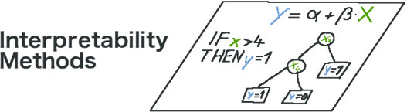
Data lifecycle
Interpreting a model means understanding why it gives a certain output for given inputs. You extract insights.
Models vary in transparency:
Some are easier to interpret (e.g. linear regressions)
Some are very complex (e.g. Random Forests)
Complex models capture richer interactions in systems
They are more accurate, but do not necessarily yield a “truer” representation
Capture + process
Learn
Extract
Notes:
Some people do not care about interpretation, they just want outputs. This can raise many questions also.
Do we want our model to be a true representation of the system? Is giving accurate outputs enough?
It has always been a trend in data science that the best models are the ones that make the best predictions. Just look at Kaggle competitions: the aim is often to maximise predictive power. Explainability is rarely a concern.

Slide 38

Data lifecycle
The (arguably) hardest part is communicating: informing people of the insights you gathered and advising them.
Many challenges:
Misinterpretation, both on your end or on your public
Communicating the limits of your analyses
Resistance to findings or to act
Knowledge gap between you and your audience
Capture + process
Learn
Extract
Inform

Slide 39
Data lifecycle
You could argue that data and the knowledge you extract are mostly rhetorical devices to influence and guide decision makers
Capture + process
Learn
Extract
Inform

Slide 40
Data lifecycle
Notice that each step so far required some decision, modification, interpretation as to how to represent and understand the phenomenon you initially wanted to measure
Saying data is objective can be misleading when every step involved since its creation involved some degree of subjectivity
Capture + process
Learn
Extract
Inform

Slide 41
Data lifecycle
This does not mean you should never trust data, or that it is always “false”
But there is tribalism in data science practices and how it is taught (even at the AMSE):
Data is objective, it’s a fact
You should clean your data, eliminate outliers, remove missing values
You should keep the “best” model, that minimizes some error or optimize accuracy
Fitting increasingly complex linear regressions models (econometrics) or boosted trees
Ask yourself why:
Is my data truly objective?
What does it mean to “clean” data? To remove information?
Is the most precise model a good representation of what I wanted to analyse in the first place? Is it always desirable to choose the “best” model?
What are the assumptions underlying my model? Do they make sense to model the system I am interested in?
Notes:
This is a concept that is often talked about in humanities/social sciences (so, sociology, anthropology), which are very critical of how “data” is considered in hard sciences: something that is factual, true, objective.

Slide 42
Data lifecycle
As data scientists, we tend to repeat similar patterns: modifications, data cleaning and modelling strategies, visualizations and communications…
These are not always scientific choices, they are derived from habits, culture, the field you work in…
It’s important to keep a critical view of your tools
If all you have is a hammer, everything looks like a nail
Don’t forget data is a representation of reality
Reality is what you are interested in, not the data
Notes:
That’s also, imo, what will distinguish you from people in computer science who do AI, in that you first started with economics, and you are used to critically thinking about models.
There are recruiters that are sensitive to this.

Slide 43
I. Defining needs

Slide 44


Back to business
Let’s stop philosophy for now and focus on more practical things
As a data worker, your projects always start with a query, by a client, product owner, boss...
First task you will do on any new project: planning.
Bernard, 1968 HEC graduate
Tip
As soon as you get your first job, keep in mind you are the specialist who knows how to make data talk (and no longer a student). This is also applicable to your interviews.

Slide 45
Planning analyses (1)
Good practice: prepare a data analysis plan (a roadmap)
What to plan: data collection, variable selection and modifications, imputation, weighting, which models, etc. etc.
Choosing the right tools (e.g. programming language) is also more important than you think
Did you know?
Sometimes (in clinical research for example), all analyses must be planned.
If you decide to change even one thing, you must discard the data and start everything from scratch.
Notes:
Note: I won’t give a specific layout for this, you do whatever you want. It’s just suggestions, and what I do personally

Slide 46
Planning analyses (2)
In some jobs, a data analysis plan may be a requirement (in this case, you have a predetermined layout to follow)
If not, you should put:
Data collection methodology
Quick description of the metadata: variables, their types, how many observations, are there clusters, is it a sample or administrative data…
The question you are trying to answer
Software/languages you are going to use
Variables selected for analyses
What analyses will be made
How results will be interpreted (coefficients? Metrics? Graphs? Something else?)
Ideally, do this before taking deep looks at the data (otherwise, you might be biased by the results you have already found)
Notes:
If it’s not a requirement, keep it simple

Slide 47
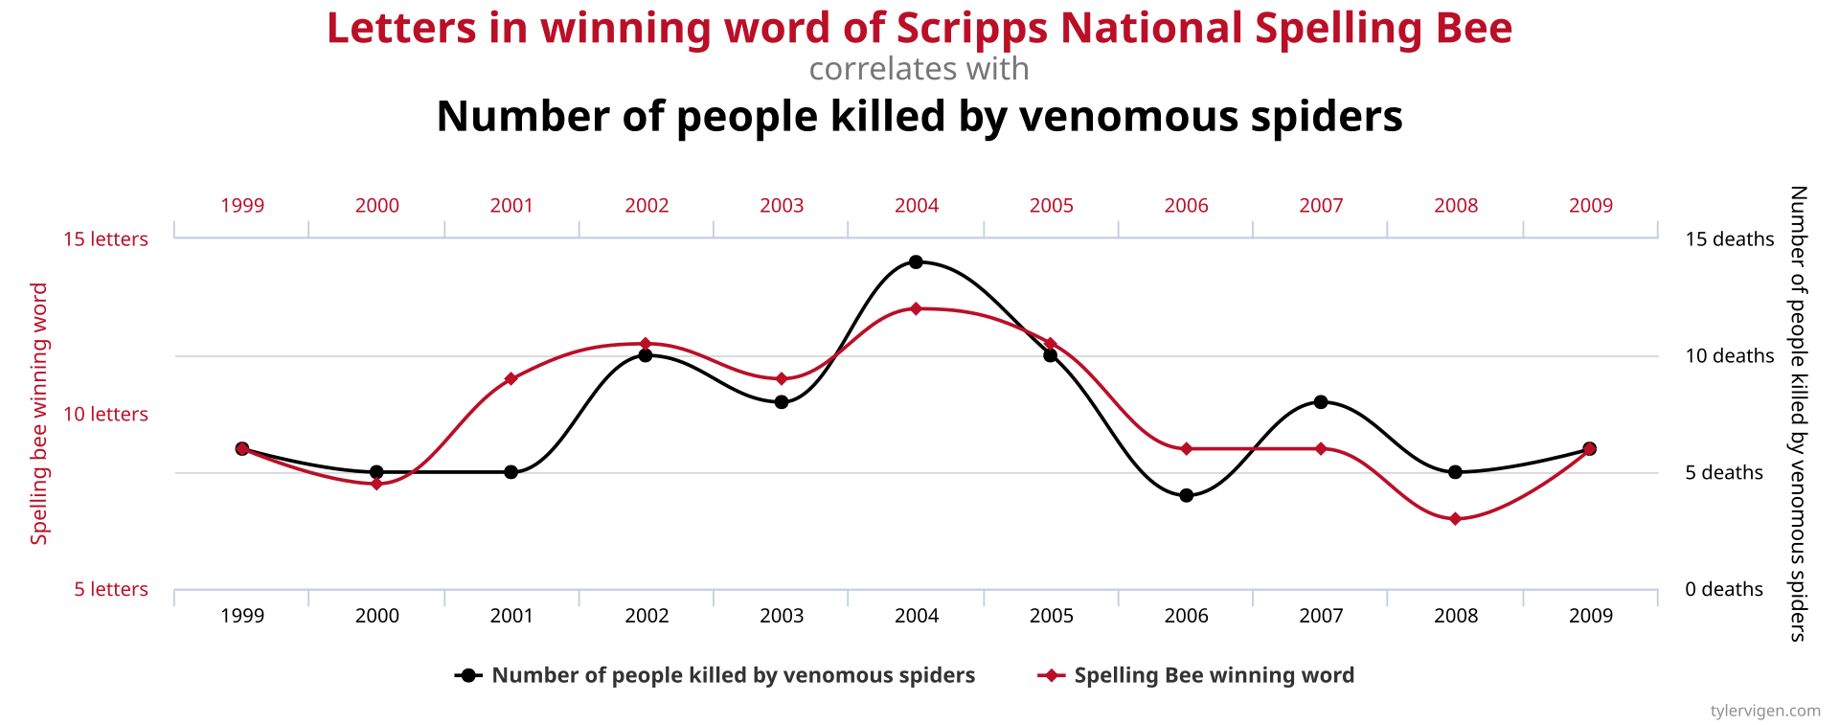
Planning analyses (3)
In practice, you may somewhat deviate from your analysis plan and add to it (post hoc)
See it as a baseline for your work…
…but don’t push it just to get significant results (“p-hacking”)
“If you torture the data long enough, it will confess to anything” (Coase R.)
After you have started working on your data, keep your final methodology and results somewhere:
Cleaning and modifications in the data that you have made
Analyses you have done
Graphs, tables, etc.
Notes:
P-hacking can be:
Taking subsets of the data to get significant results
Only showing significant results
Include covariates to get significant results
Transforming the data to get significant results
Graph : spurious correlations website: https://tylervigen.com/spurious-correlations

Slide 48
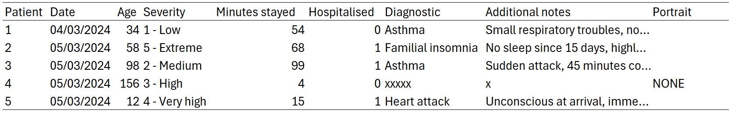




Common variable/data types
Notes:
Ask students what data type there is on the table

Slide 49



Quantitative variables
Discrete or continuous numerical variables
Numerical data in R can be stored as:
Integers, if there are no decimals
Floats, called “numeric” or “double” in R (for double-precision floating-point, meaning a number is accurate up to the 15th decimal)
This difference exists because integers have lower memory consumption

Slide 50

Dates
Well, it’s a date.
Watch out for time zones
Use the lubridate package to manipulate dates (not base R)
Common error
Check that your date variable is in “Date” or “POSIT” format, not “character”. This will cause errors.

Slide 51



Qualitative variables
Ordered variables, like severity: 1 > 2 > 3 > 4 > 5
Unordered (or nominal) variables, like Diagnostic (or Hospitalised)
Hospitalised is a special case called a binary variable, because it takes only two values
Qualitative variables can be stored as:
Strings, a sequence of characters (character type in R)
Factors, in R (a type made for categorical data, that can be ordered, and is more memory efficient than strings)

Slide 52

Text
You can do a lot of things with texts (which we won’t cover here)
You can create new nominal variables by hand from the texts content, for example
Or you can do more sophisticated work using Natural Language Processing (NLP)
These are always stored as strings/characters types

Slide 53

Images
You can also do a lot of things with images (which we won’t cover here)
This is a very specialized field, it is unlikely you will work on images
R is not the best choice for working with images, opt for Python instead (also this requires beefy workstations)

Slide 54
What analyses?
Descriptive
It’s a requirement, always describe your data
This is useful both for the decision maker to understand your data, but especially for you
Exploratory
Everything you do can be exploratory, actually (it’s an attitude, more than a set of techniques)
Dimensionality reduction techniques (principal components analysis, multiple correspondence analysis…) allow you to find latent factors (~underlying variables) from what you have
Modelling
See next slides
Notes:
Interpretability vs. flexibility tradeoff: do you know what it is

Slide 55
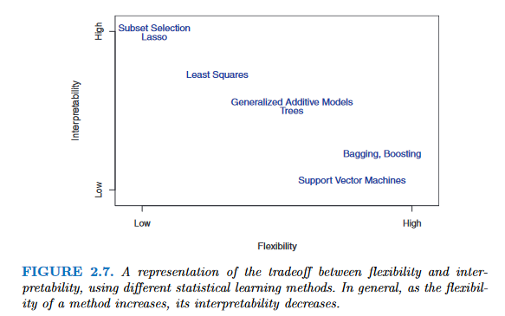
What models?
Interpretability vs. flexibility tradeoff
Decision makers want to know why you are getting the results you have
More flexible models, though more accurate, may be less valued because they are hard to understand
Sometimes, people just want coefficients from a regression model, or a single decision tree
From James GM. 2013. Introduction to statistical learning.
Notes:
Interpretability vs. flexibility tradeoff: do you know what it is

Slide 56
What models, but for my data? (1)
Always check the literature first, there may be specific estimation procedures to follow
In your research question, do you know what you have to estimate?
Yes, I have a dependent variable which I must predict/for which I must find associated factors ➔ Supervised methods (regressions, trees, kNN, etc.)

Slide 57
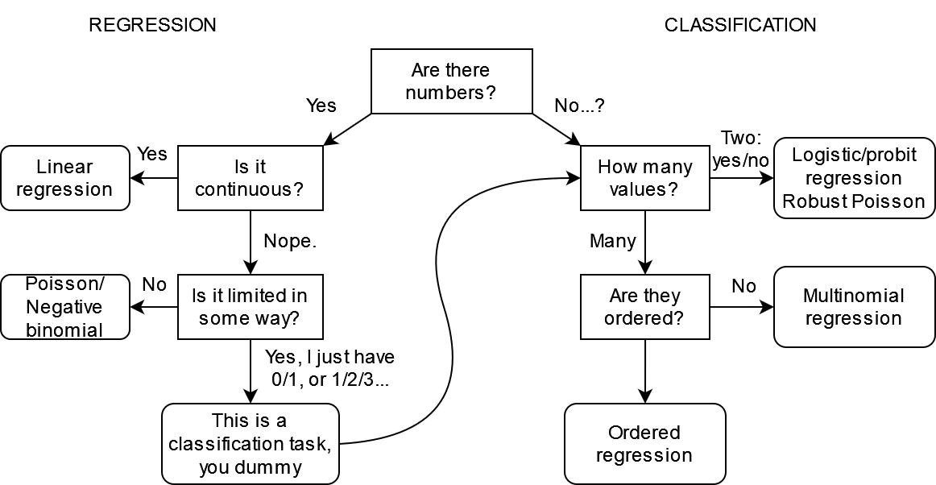

Supervised learning
Non-exhaustive list of commonly used linear models, and when to use them
Dep. variable
(i.e. is the data numerical?)
é
Note: you may use some ML models for both regression and classification, and may be robust to some specifications of the dependent variable

Slide 58
Supervised learning
Non-exhaustive list of commonly used linear models, and when to use them
Dep. variable
(i.e. is the data numerical?)
Note: you may use some ML models for both regression and classification, and may be robust to some specifications of the dependent variable

Slide 59
Some weird cases (1)
Watch out for limited dependent variables:
Variables with limited range of values (e.g. scales from 1 to 5)
In this case, don’t use a linear regression model
Test ordered logit/probit models
Or multinomial logit/probit if ordered logit assumptions are violated
Censoring and truncation
Censoring: you observe some floor or ceiling values in your dependent variables (e.g. annual income variable coded as >100,000€ when the true annual income is over this threshold).
Truncation: same as censoring, but the entire observation is missing from the data when the threshold is hit
Notes:
Note: here censoring is in the dependent variable. Censoring exists in survival analysis, but it refers to the observation window of participants in the study

Slide 60

Some weird cases (2)
You will encounter situations where you could have multiple candidate models
Example: length of stay in a hospital
You could model that with a (robust) linear regression…
But it’s strictly positive and discrete, so you could use a poisson/negative binomial regression
Zero-inflated, if you have a lot of zeroes…
Or throw everything out the window: it’s time-to-event data, so use survival analyses methods (Accelerated Failure Time, Cox…)
pov: reviewer 2 about to nuke your whole career
Notes:
Model selection is also a choice. There may be not “best” model that represent what you are trying to understand.
Maybe your selection will be based on some metric, minimising some loss function (RMSE, MAE…). But why? Is a model that minimises some error truly representative of the underlying phenomenon you wanted to measure in the first place?

Slide 61
What models, but for my data? (2)
Always check the literature first, there may be specific estimation procedures to follow
Do you know what you have to estimate?
Yes, I have a dependent variable which I must predict/for which I must find associated factors ➔ Supervised methods (regressions, trees, knn, etc.)
No? ➔ Unsupervised methods (clustering)

Slide 62
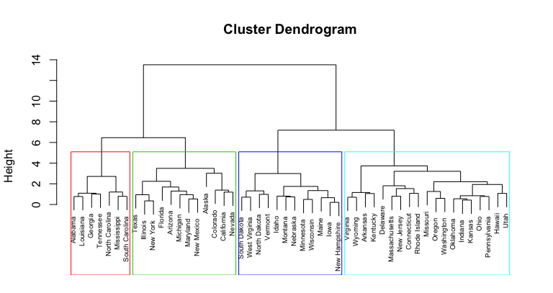
Unsupervised learning (1)
You don’t have a dependent variable, but you want to find groups in your data
Use clustering methods:
Hierarchical clustering (in my experience, this has always yielded good results)
K-means
OPTICS, DBSCAN…
These projects are a lot more exploratory:
You may propose multiple clustering methods
There are criteria to find an optimal number of clusters…
But don’t forget that the “best” clustering is the one that makes sense

Slide 63
Unsupervised learning (2)
Always check the characteristics of your clusters:
Cross-tabulate your groups with the variables you used as inputs in the algorithm
Or cross-tabulate with other variables that were not included as inputs
Good resources
https://scikit-learn.org/stable/unsupervised_learning.html
Cluster Analysis, 5th edition. https://cicerocq.wordpress.com/wp-content/uploads/2019/05/cluster-analysis_5ed_everitt.pdf
FactoMineR package. http://factominer.free.fr/index.html

Slide 64
What models, but for my data? (3)
Always check the literature first, there may be specific estimation procedures to follow
Do you know what you have to estimate?
Yes, I have a dependent variable which I must predict/for which I must find associated factors ➔ Supervised methods (regressions, trees, knn, etc.)
No? ➔ Unsupervised methods (clustering)
There are other paradigms:
Reinforcement learning
Semi-supervised
And others…

Slide 65
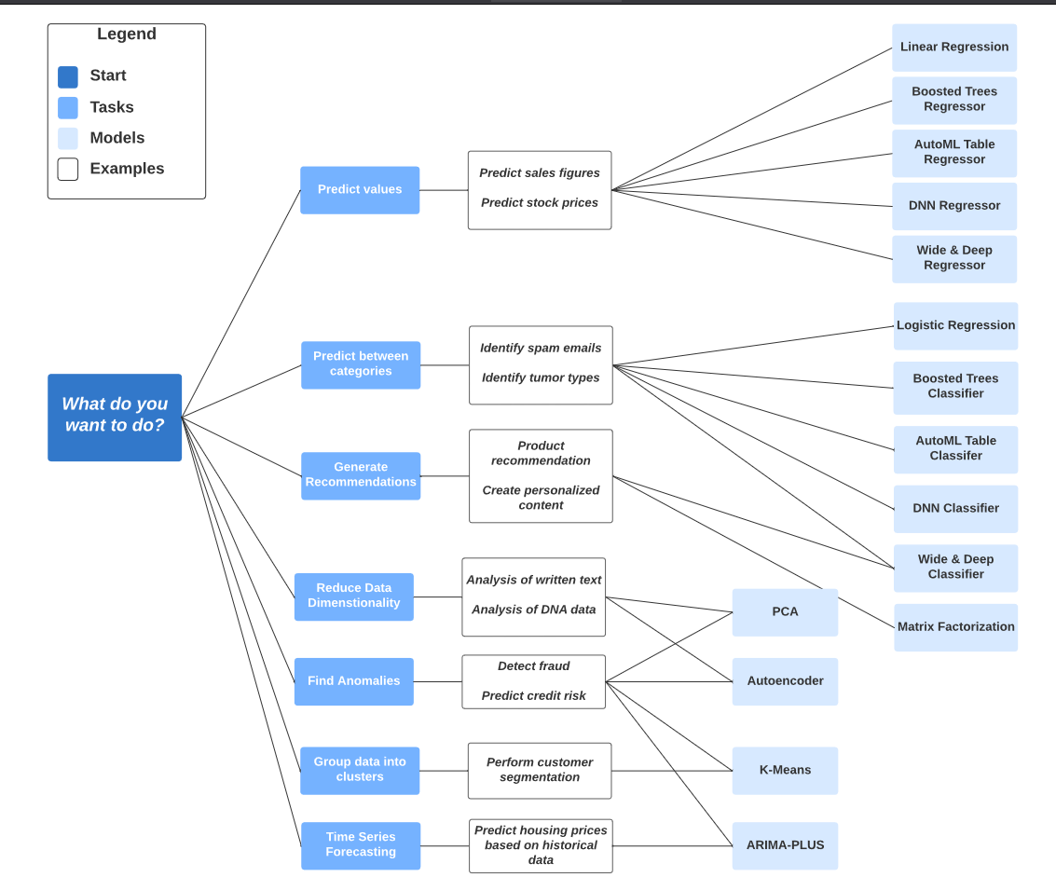
Google Big Query models cheat sheet
Non-exhaustive too, but it’s a useful cheat sheet depending on what you want to do

Slide 66

What variables to include?
Make ex-ante hypotheses, ideally based on:
Existing literature
Your own theoretical framework
You may add variables ex-post in your analyses (if your project allows it)
But don’t mine for statistically significant associations (aka “p-hacking”), significant risk of false positives
Watch out for data leakage in variables (mostly in prediction):
Information in historical data that should not be available when the model is run
Different from data leakage in observations: information from test data inside the training data

Slide 67
What potential biases?
We will see that later in the course, but at that point you should ask yourself if they may be biases in your data or in your future analyses:
Endogeneity (simultaneity, omitted variables…)
Sample selection
Attrition
Psychological biases in surveys (desirability…)
Biases are hard to find, especially without seeing the data. You may find problems with your data as you go along in your project.

Slide 68
What to report?
Very important:
You don’t do analyses in a vacuum, you are doing all this work to show results
Find out what the client wants:
Interpretable results? ➔ Use less flexible, more interpretable models
Just good, accurate results? ➔ Use big black box models!
Charts? An interactive dashboard?
Keep in mind these things take time, try to estimate how much time each thing will take (it’s hard even for seniors!)

Slide 69

How much resources?
Panicked data scientist who found out the hard way their data is too big
You may encounter hardware limitations
Hard to predict at beginner level
Some data wrangling on medium sized data may be too much for your computer to handle
Or a model (e.g. Random Forest) requires too much resources
How to solve?
Ask for a beefier computer (easiest solution, but costly)
Choose the right language & packages, write better code (cf chapter III)
Cloud computing (for Big Data)

Slide 70
What programming language? (1)
As a beginner, if you have the choice, use the one you are the most comfortable with…
But you won’t always have the luxury of choosing:
Some models may not be implemented (or implementable) in the language of your choosing
The language may not be suited for what you want to do
You may be working on virtual environments that only have specific programming languages

Slide 71
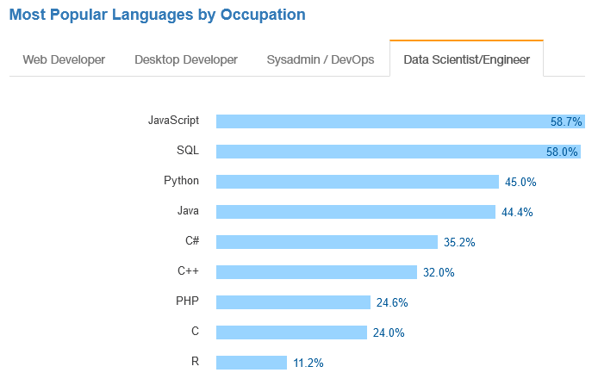





Popular languages
No real studies (afaik) on the most used languages among data scientists
Usually R/Python, with other languages being more situational
🤔
🤔🤔🤔
Stackoverflow Developer Survey 2017

Slide 72


Popular languages: the big ones
Python: good to learn, mostly used for Machine Learning
Quite limited for stats compared to R (e.g. survey weighting, time series…)
Outside of stats/ML, used in software engineering
R: great for stats, still OK for ML
Use Python if you want to do Deep Learning or work on textual data
Some data scientists use both
You could use one as your ‘main’ language, and the other one for specific use cases
SQL: great if you work on big databases
If you use R, you can get away without knowing too much with dbplyr (automatically translates dplyr pipelines to SQL queries)

Slide 73

Popular languages: the paid ones
SAS
Good investment to learn IF you work in the financial (banks) or healthcare sectors (Contract Research Organisations)
These are high paying jobs; companies have difficulties hiring SAS users
Not that useful elsewhere: syntax is clunky and obsolete, lack of commonly available tools in other IDEs (debugger, GitHub integration…), VERY expensive
Opinionated take: your lecturer expects SAS usage to decrease as companies try to cut costs, there is a trend of migrating from SAS ➔ R.
Stata, SPSS, MatLab…
Don’t bother, very rarely asked in job offers
Some statistical software (e.g. Stata) may have econometric models still not developed in R, so their use may be situational

Slide 74



Rising languages?
Julia, Rust, Go…
Some popularity for these languages in the data science community (especially Julia)
Considered to be very performant
These languages are young (Julia came in 2012, while R/Python have been here for ~30 years), as are their ecosystems of packages
At this stage, nothing indicates that R/Python are falling out of favour
Nevertheless, keep an eye on emerging programming languages, one day you may have to do the switch

Slide 75

Some last ones
HTML & CSS
Very useful if you want to make good-looking dashboards or websites
C/C++
Many R functions are actually written in C or C++ (check out Rcpp package)
If you write custom functions for time-critical applications, porting some of these functions to C++ can give you the speed you look for
However, this is unlikely to concern you

Slide 76
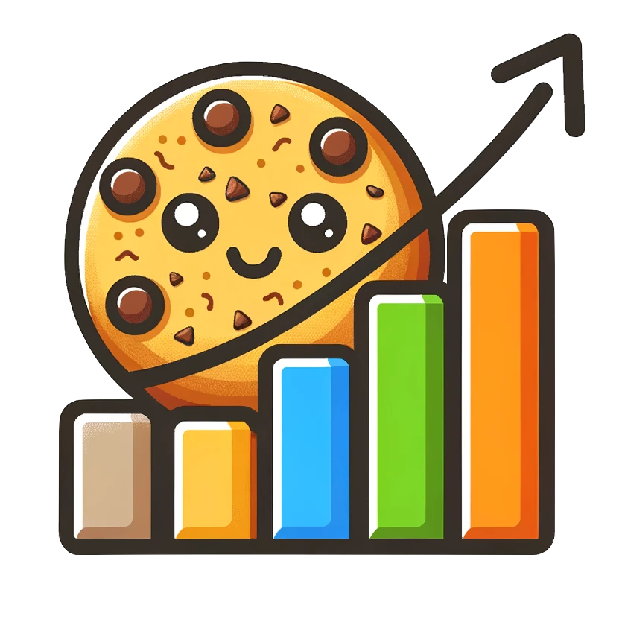
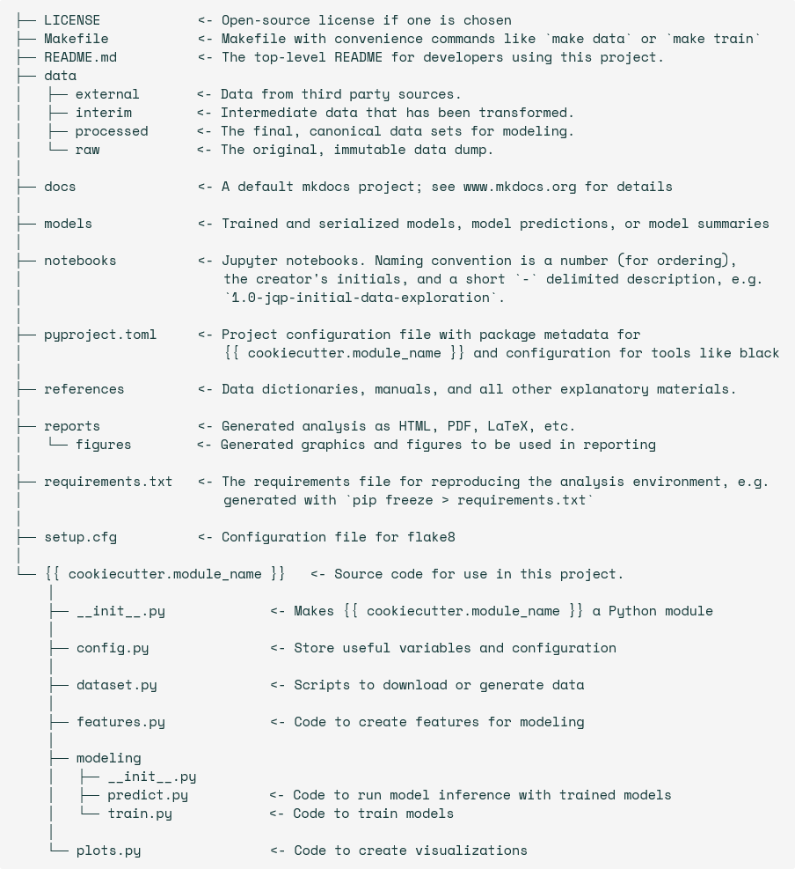
Cookiecutter Data Science
Python package that provides a basic project structure for data science work: https://cookiecutter-data-science.drivendata.org/
With other programming languages, just copy the folder structure
Useful when working with others: this is a commonly used skeleton for projects, and other data scientists won’t be lost when working on your project

Slide 77
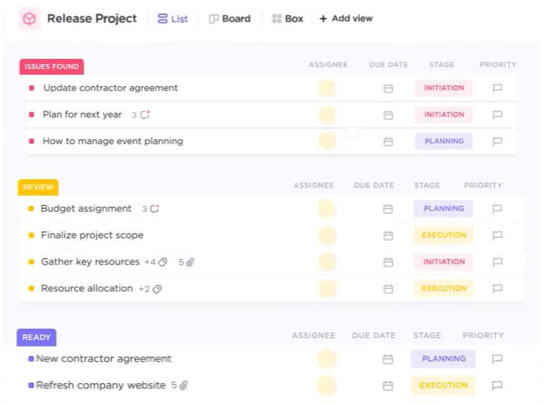
Working with others
Git (+ GitHub, GitLab…)
Version control software: keeps track of all modifications in files of a project
Great when working alone to keep a history of all changes you have made
Great when working with others, to check new modifications, review their code…
Project management tools: Trello, ClickUp…
Used to plan all steps in a project
Very useful if you work on multiple projects to keep track of all you have to do
Also great to check or report progress on tasks

Slide 78
In two weeks
Programming in R:
R programming refresher (hopefully)
Big exercise
Install R and R Studio

